Slide 1
Week 6….
NETWORK MODELS

Slide 2
Needs for Architectures and Standards
Complex communication systems
Maintenance and future growth
Connectivity between network devices
Distributed processing systems
Diagnostic and performance management

Slide 3
Standards-Making Organizations
International Telecommunications Union-Telecommunication Standardization Section (ITU-T)
International Organization for Standardization (ISO)
American National Standard Institute (ANSI)
Electrical Industries Association (EIA)
National Institute of Standards and Technology (NIST)
Institute of Electrical and Electronic Engineers (IEEE)

Slide 4
Communication Standards
Rules for compatibility
Specify “how”-the protocol

Slide 5


What’s a protocol?
a human protocol and a computer network protocol:
Hi
TCP connection
req
Hi
TCP connection
response
Got the
time?
Get http://www.awl.com/kurose-ross
2:00
<file>
time

Slide 6
Pros and Cons of Standards
Pros
Compatibility between vendors
Fewer products
Cons
Slow processing
Obsolescence
Freezing technology
Discouraging innovation

Slide 7
OSI MODEL

Slide 8
Open System Interconnection Model
International Organization for Standardization
Interconnection of Dissimilar Network
Seven Layers(All People Sometimes Need Data Processing)
Application(Layer 7)
Presentation
Session Control
Transport Control
Network Control
Data Link Control
Physical Link Control(Layer 1)

Slide 9
Communication Architecture
Strategy for connecting host computers and other communicating equipment.
Defines necessary elements for data communication between devices.
A communication architecture, therefore, defines a standard for the communicating hosts.
A programmer formats data in a manner defined by the communication architecture and passes it on to the communication software.
Separating communication functions adds flexibility, for example, we do not need to modify the entire host software to include more communication devices.

Slide 10
Layer Architecture
Layer architecture simplifies the network design.
It is easy to debug network applications in a layered architecture network.
The network management is easier due to the layered architecture.
Network layers follow a set of rules, called protocol.
The protocol defines the format of the data being exchanged, and the control and timing for the handshake between layers.

Slide 11
Open Systems Interconnection (OSI) Model
OSI Model
International standard organization (ISO) established a committee in 1977 to develop an architecture for computer communication.
Open Systems Interconnection (OSI) reference model is the result of this effort.
In 1984, the Open Systems Interconnection (OSI) reference model was approved as an international standard for communications architecture.
Term “open” denotes the ability to connect any two systems which conform to the reference model and associated standards.

Slide 12
OSI Reference Model
OSI Model
The OSI model is now considered the primary Architectural model for inter-computer communications.
The OSI model describes how information or data makes its way from application programmes (such as spreadsheets) through a network medium (such as wire) to another application programme located on another network.
The OSI reference model divides the problem of moving information between computers over a network medium into SEVEN smaller and more manageable problems .
This separation into smaller more manageable functions is known as layering.

Slide 13
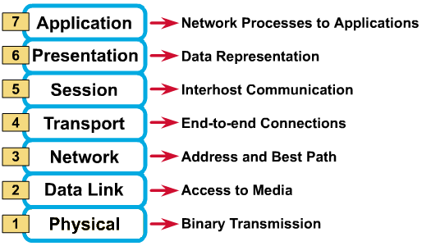
OSI Reference Model: 7 Layers
OSI Model

Slide 14
OSI: A Layered Network Model
OSI Model
The process of breaking up the functions or tasks of networking into layers reduces complexity.
Each layer provides a service to the layer above it in the protocol specification.
Each layer communicates with the same layer’s software or hardware on other computers.
The lower 4 layers (transport, network, data link and physical —Layers 4, 3, 2, and 1) are concerned with the flow of data from end to end through the network.
The upper four layers of the OSI model (application, presentation and session—Layers 7, 6 and 5) are orientated more toward services to the applications.
Data is Encapsulated with the necessary protocol information as it moves down the layers before network transit.

Slide 15
Physical Layer
OSI Model
Provides physical interface for transmission of information.
Defines rules by which bits are passed from one system to another on a physical communication medium.
Covers all - mechanical, electrical, functional and procedural - aspects for physical communication.
Such characteristics as voltage levels, timing of voltage changes, physical data rates, maximum transmission distances, physical connectors, and other similar attributes are defined by physical layer specifications.

Slide 16
Data Link Layer
OSI Model
Data link layer attempts to provide reliable communication over the physical layer interface.
Breaks the outgoing data into frames and reassemble the received frames.
Create and detect frame boundaries.
Handle errors by implementing an acknowledgement and retransmission scheme.
Implement flow control.
Supports points-to-point as well as broadcast communication.
Supports simplex, half-duplex or full-duplex communication.

Slide 17
Network Layer
OSI Model
Implements routing of frames (packets) through the network.
Defines the most optimum path the packet should take from the source to the destination
Defines logical addressing so that any endpoint can be identified.
Handles congestion in the network.
Facilitates interconnection between heterogeneous networks (Internetworking).
The network layer also defines how to fragment a packet into smaller packets to accommodate different media.

Slide 18
Transport Layer
OSI Model
Purpose of this layer is to provide a reliable mechanism for the exchange of data between two processes in different computers.
Ensures that the data units are delivered error free.
Ensures that data units are delivered in sequence.
Ensures that there is no loss or duplication of data units.
Provides connectionless or connection oriented service.
Provides for the connection management.
Multiplex multiple connection over a single channel.

Slide 19
Session Layer
OSI Model
Session layer provides mechanism for controlling the dialogue between the two end systems. It defines how to start, control and end conversations (called sessions) between applications.
This layer requests for a logical connection to be established on an end-user’s request.
Any necessary log-on or password validation is also handled by this layer.
Session layer is also responsible for terminating the connection.
This layer provides services like dialogue discipline which can be full duplex or half duplex.
Session layer can also provide check-pointing mechanism such that if a failure of some sort occurs between checkpoints, all data can be retransmitted from the last checkpoint.

Slide 20
Presentation Layer
OSI Model
Presentation layer defines the format in which the data is to be exchanged between the two communicating entities.
Also handles data compression and data encryption (cryptography).

Slide 21
Application Layer
OSI Model
Application layer interacts with application programs and is the highest level of OSI model.
Application layer contains management functions to support distributed applications.
Examples of application layer are applications such as file transfer, electronic mail, remote login etc.

Slide 22
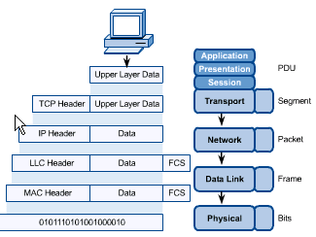
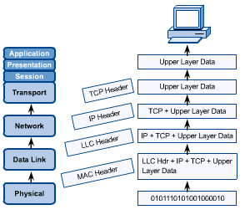
OSI in Action
OSI Model
A message begins at the top application layer and moves down the OSI layers to the bottom physical layer.
As the message descends, each successive OSI model layer adds a header to it.
A header is layer-specific information that basically explains what functions the layer carried out.
Conversely, at the receiving end, headers are striped from the message as it travels up the corresponding layers.

Slide 23
Pros and Cons of Layered Architectures
Pros
Modularize structure for simplify maintenance
Specify interfaces for easy change & future growth
Cons
Complex Rules
Cost of sophisticated intelligence
Complex software

Slide 24
TCP/IP Model
TCP/IP MODEL

Slide 25
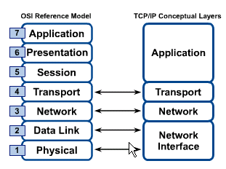
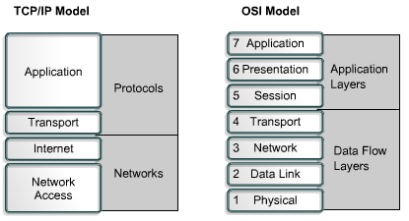
OSI & TCP/IP Models
TCP/IP Model

Slide 26
TCP/IP Model
TCP/IP Model
Application Layer
Application programs using the network
Transport Layer (TCP/UDP)
Management of end-to-end message transmission,
error detection and error correction
Network Layer (IP)
Handling of datagrams : routing and congestion
Data Link Layer
Management of cost effective and reliable data delivery,
access to physical networks
Physical Layer
Physical Media

